Slide 1
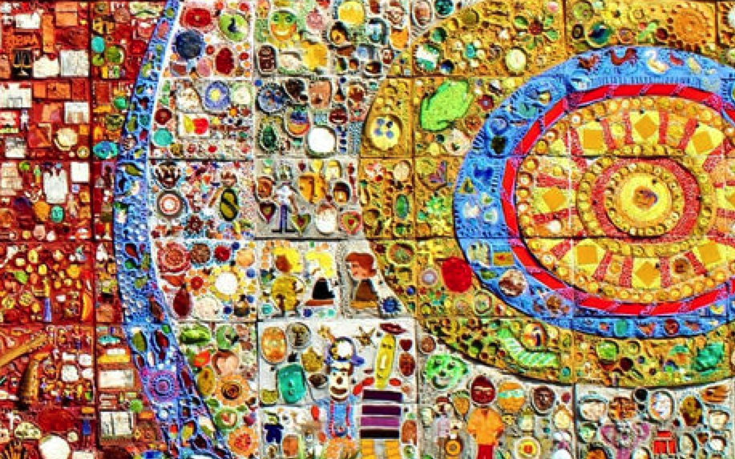
Boston’s South End
An Introduction
FOSEL January 2021
Notes:
Historic Betances Mural is a colorful mosaic tile mural. Made in 1979 and located in Plaza Betances, the center of the Villa Victoria housing community. It was the result of a movement to fight an urban renewal project that would have displaced the Puerto Rican residents of the South End in the late 1960’s. The mural was envisioned by the Artist Lilli Ann K. Rosenberg who collaborated with the community. Dr. Ramon E. Betances [1827-1898] a successful Puerto Rican activist and humanitarian who fought for Puerto Rican independence from Spain and for the emancipation of slaves.

Slide 2
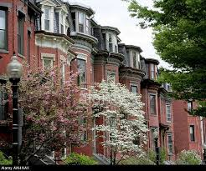
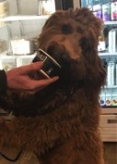
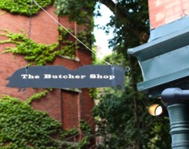
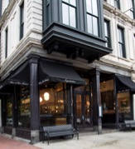
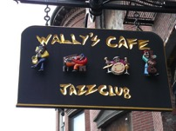
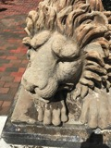
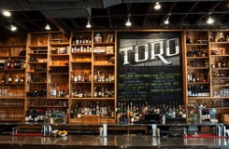
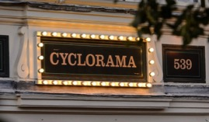
1
2
3
4
5
6
7
8
Our Community at a Glance
FOSEL January 2021
Notes:
1. Ellis Neighborhood 2. Fumo Ice Cream – South End 3. The Butcher Shop, Tremont Street – Owner is restaurateur Barbara Lynch 4. Aquitaine on Tremont Street – Owner is restaurateur Seth Woods 5. Wally’s Café, Massachusetts Ave – Landmark Jazz Club in the South End 6. Endearing landmark carved in 1872 to guard the home at 511 Columbus Ave 7. Toro Restaurant – Washington Street, award winning chefs: Ken Oringer and Jamie Bissonette 8. Cyclorama / Boston Center for the Arts – Built in 1865 to originally hold a 400’ x 50’cyclorama painting of the Battle of Gettysburg. When built it had the second largest dome in the country second to the Capital

Slide 3
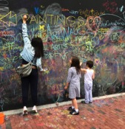
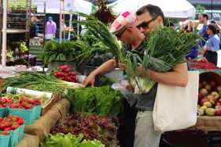
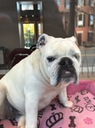
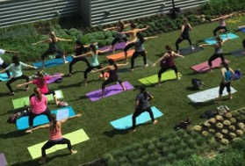
1
2
3
4
5
Our Community at a Glance
FOSEL January 2021
Notes:
1. Outdoor Chaulkboard, 450 Harrison Avenue 2. SoWa Farmers Market 3. Tips Salon beloved bulldog Kaptin on 76 Dartmouth 4. Blackbird Doughnuts 5. Outdoor green space at Ink Block

Slide 4
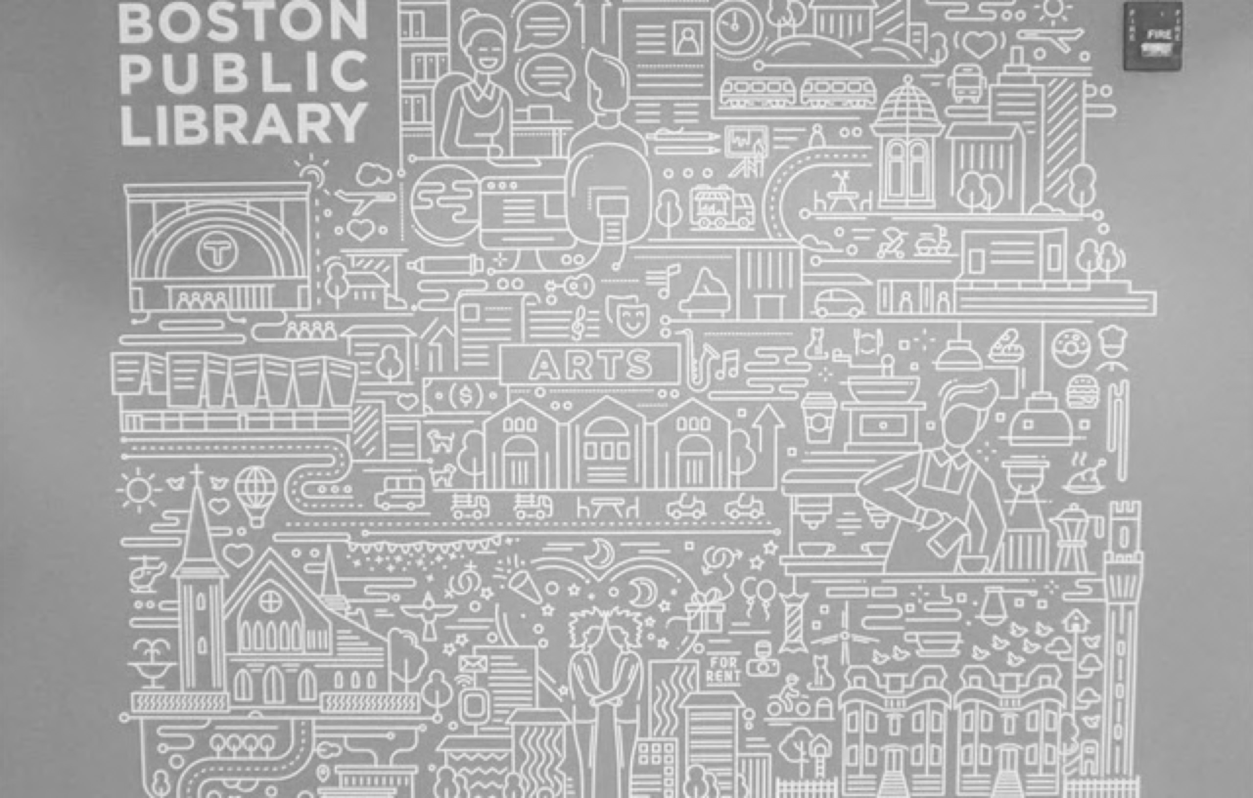
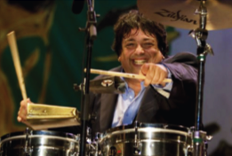
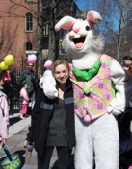
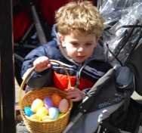
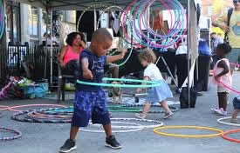
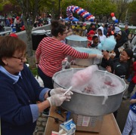
Concerts and Easter Egg Hunt in the South End Library Park
SoWa’s Outdoor Markets
Opening Day South End’s Little League
Background Image- Mural at South End Library
Our Community at a Glance
FOSEL January 2021

Slide 5
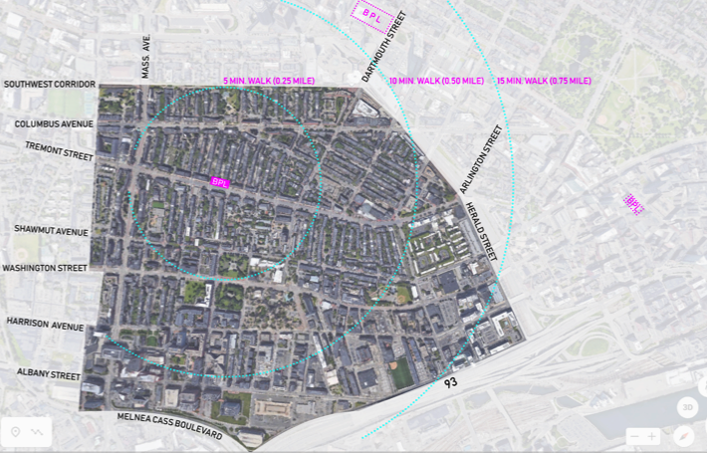
Walking Distance to the South End Library
FOSEL January 2021

Slide 6
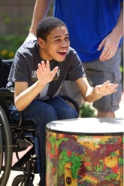
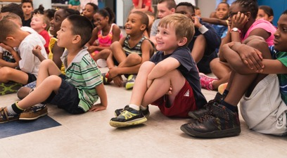
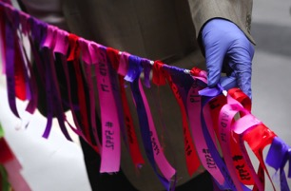
Community Organizations
Neighborhood Associations
Our Neighborhood Schools
Communities of Faith
Knowing us Beyond a Glance
FOSEL January 2021

Slide 7
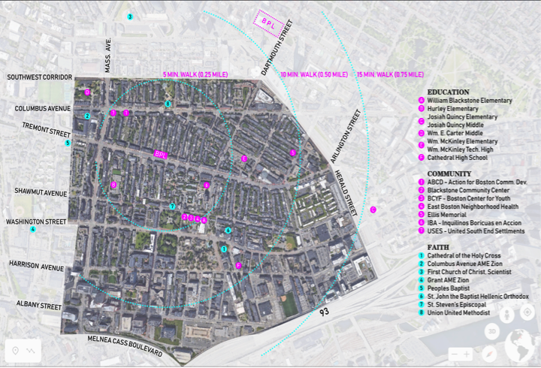
Our Community’s Ecosystem
FOSEL January 2021

Slide 8
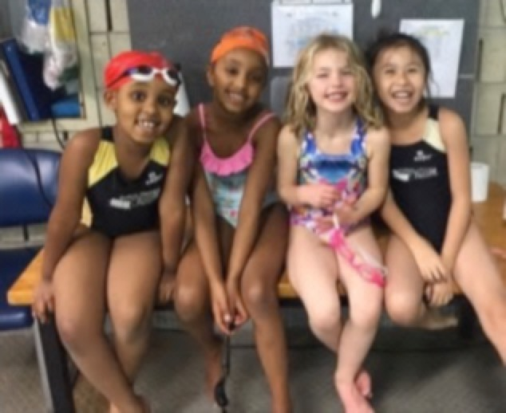
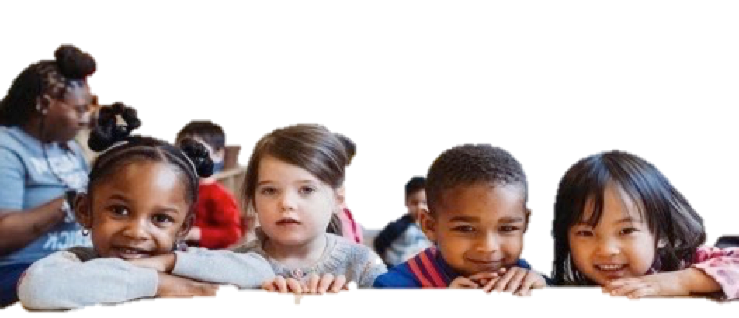
Blackstone Community Center
Community Organizations
FOSEL January 2021

Slide 9
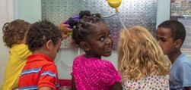
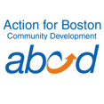
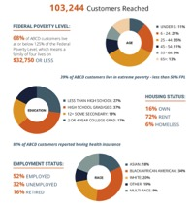
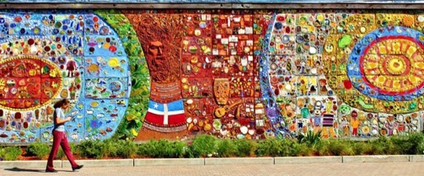
FOSEL January 2021

Slide 10
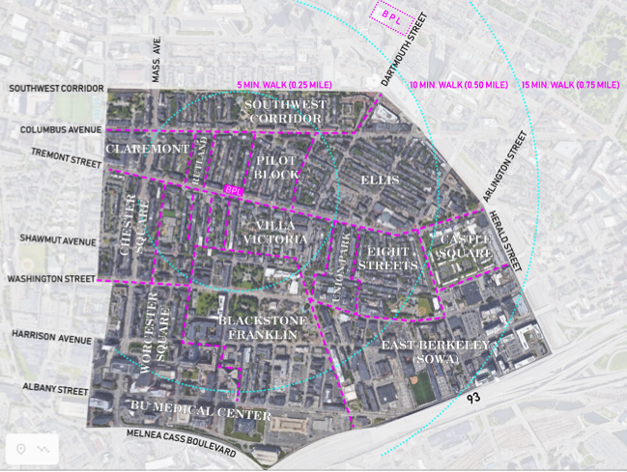
Blackstone Franklin
Castle Square
Chester Square
Claremont
East Berkley
Eight Streets
Ellis Memorial
Pilot Block
Rutland
* South End Forum
Union Square
Worcester Square
* An umbrella South End Association
Neighborhood Associations
FOSEL January 2021

Slide 11
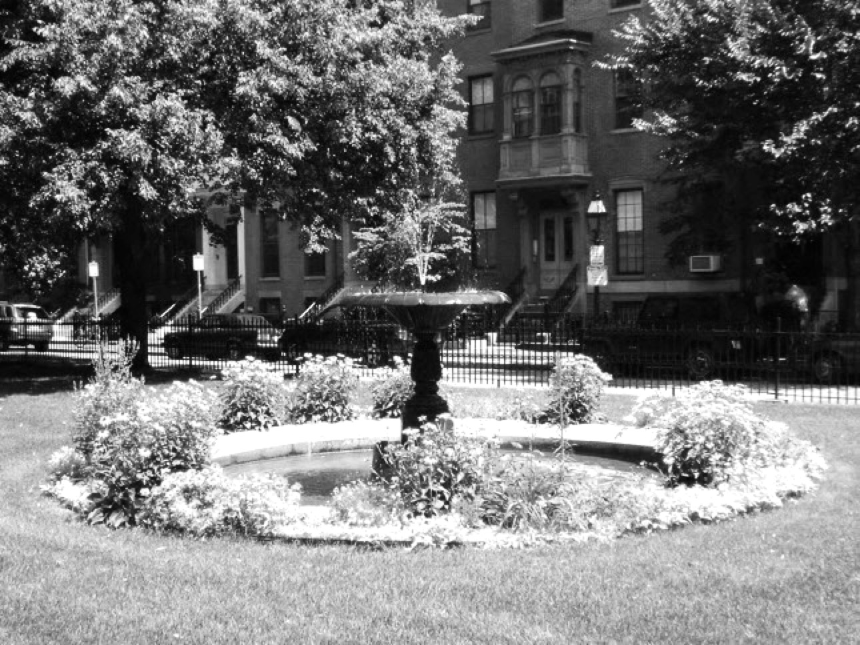
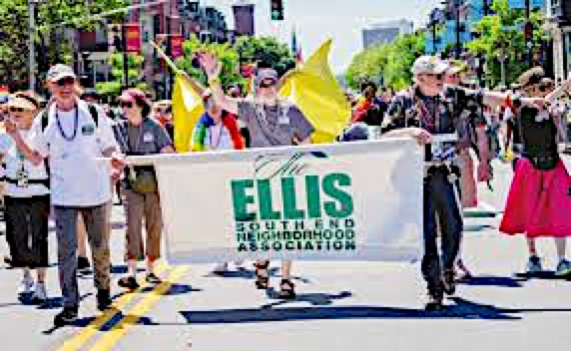
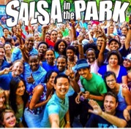
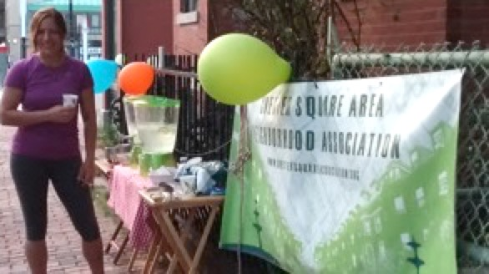
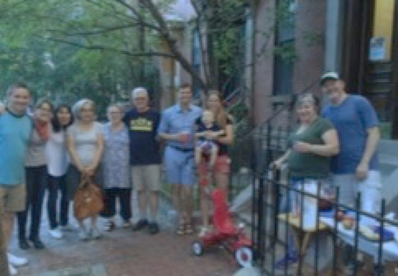
Background image: Union Square
FOSEL January 2021

Slide 12
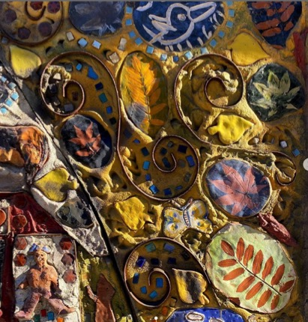
The William Blackstone Elementary School
Cathedral 7-12 High School
The Hurley K-8 School
Josiah Quincy Elementary School
Josiah Quincy Middle School
Wm. E. Carter School
William McKinley Elementary and Tech HS
Our Neighborhood Schools
FOSEL January 2021

Slide 13
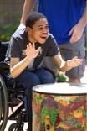
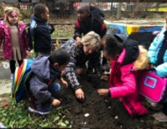
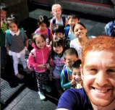
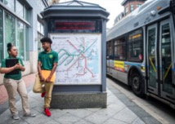
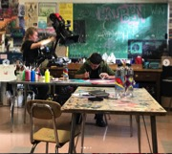
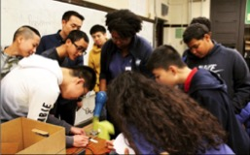
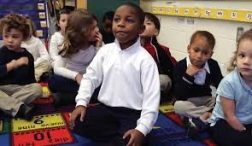
Wm. E. Carter
William Blackstone Elementary
Josiah Quincy Elementary
Cathedral High
The William B
McKinley Academy
Josiah Quincy Upper
Hurley K-8
FOSEL January 2021

Slide 14
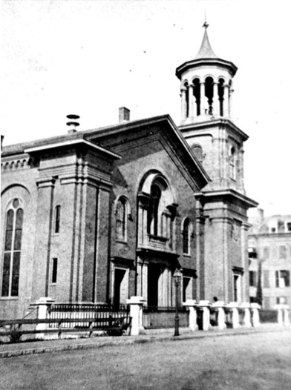
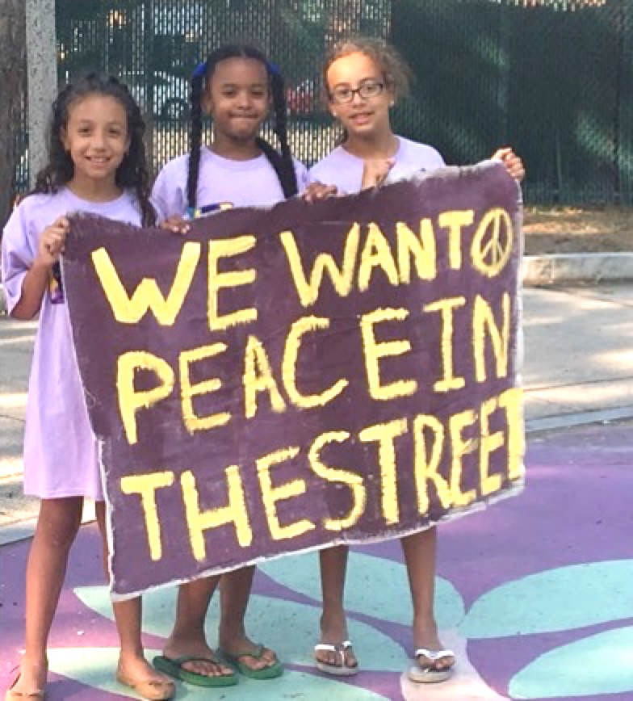
Cathedral of the Holy Cross
Columbus Avenue AME Zion Church
Grant AME [African Methodist]Church
Peoples Baptist Church
St. John the Baptist [Hellenic Orthodox Church] *
St. Steven’s - Episcopal Church
Union United Methodist Church
* Background historic image
Our Communities of Faith
FOSEL January 2021

Slide 15
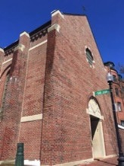
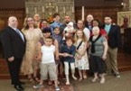
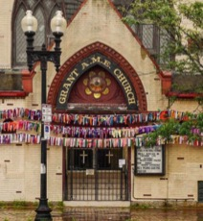
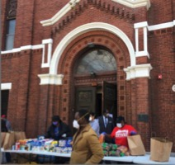
Saint Steven’s, Shawmut Ave
Columbus Avenue AME Zion Church
Grant AME [African Methodist] Church, Washington Street
FOSEL January 2021

Slide 16
FOSEL Mission: To promote and enhance the value of the South End Library and Library Park as a cultural, informational, and educational asset for the South End community, free to all, through programs, activities, and financial support.
The Friends of the South End Library
January 2021

